Slide 1

Predicting London Mean Temperature
Michael Le

Slide 2
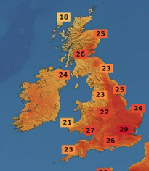
Purpose
The purpose for this project is to predict London mean temperatures using the of the dataset containing weather London data from Kaggle.com recorded by a weather station near Heathrow airport in London, UK. Consists of 15341 observations taken from 01-01-1979 to 31-12-2020 with 10 attributes. Enabling informed decisions to forecasting weather, climate change, energy management and agriculture.

Slide 3

Procedure
The procedure to start the analysis, I have installed the dataset from Kaggle. I have started using Python one of the programming languages used for data analysis and predictive modelling. Such as Numpy, Pandas, Matplotlib, Seaborn and Scikit-learn to collect and transform raw London weather data to perform predicting modelling on the mean temperature shown in Steps 1 and 2.
Notes:
Generated by Copilot To kick off our analysis, I've sourced the dataset from Kaggle, which is a reputable platform for data science resources. I'm utilizing Python, a powerful programming language favored for data analysis and predictive modeling. Key libraries such as Numpy and Pandas are instrumental for data manipulation, while Matplotlib is used for visualizations. Scikit-learn will facilitate our predictive modeling efforts, specifically focusing on forecasting mean temperatures based on the raw weather data from London. This approach not only allows us to clean and transform the data effectively but also sets the stage for robust predictive insights. ______

Slide 4
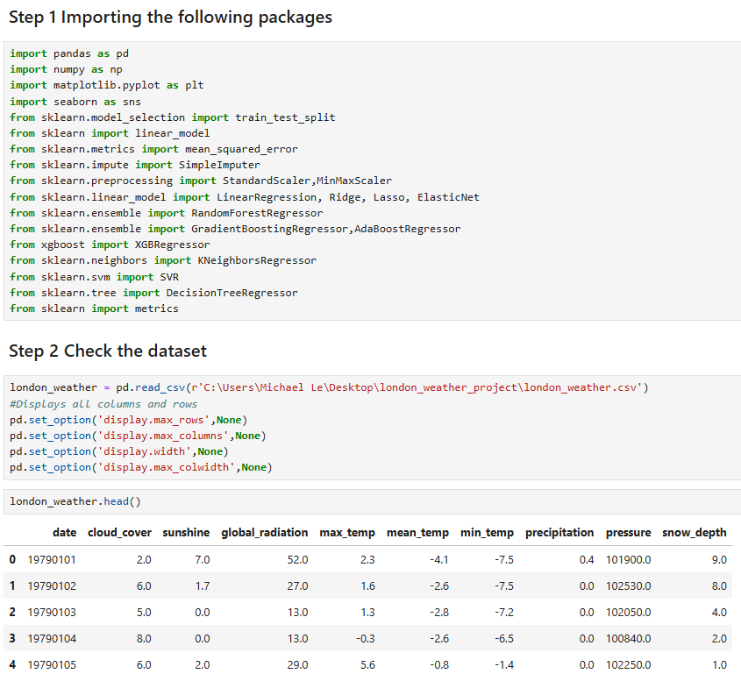
Steps 1 and 2

Slide 5

Data Cleaning
In the next step, we need to clean our London-weather data. Removing duplicates, changing data-types and rows that contains NaN values to improve data accuracy, relibability and consistency leading to more effective analysis shown in Step 3.

Slide 6
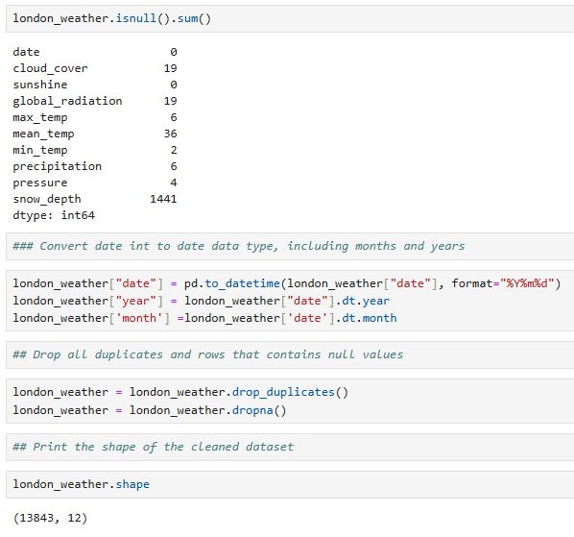
Step 3

Slide 7

Data Exploratory Analysis
For this selection we plot different temperatures for maximum, minimum and average temperatures that occur within 1970 to 2020. To help us identify any patterns, errors and make informed decisions before deciding to build our predictive models to validate our findings.

Slide 8
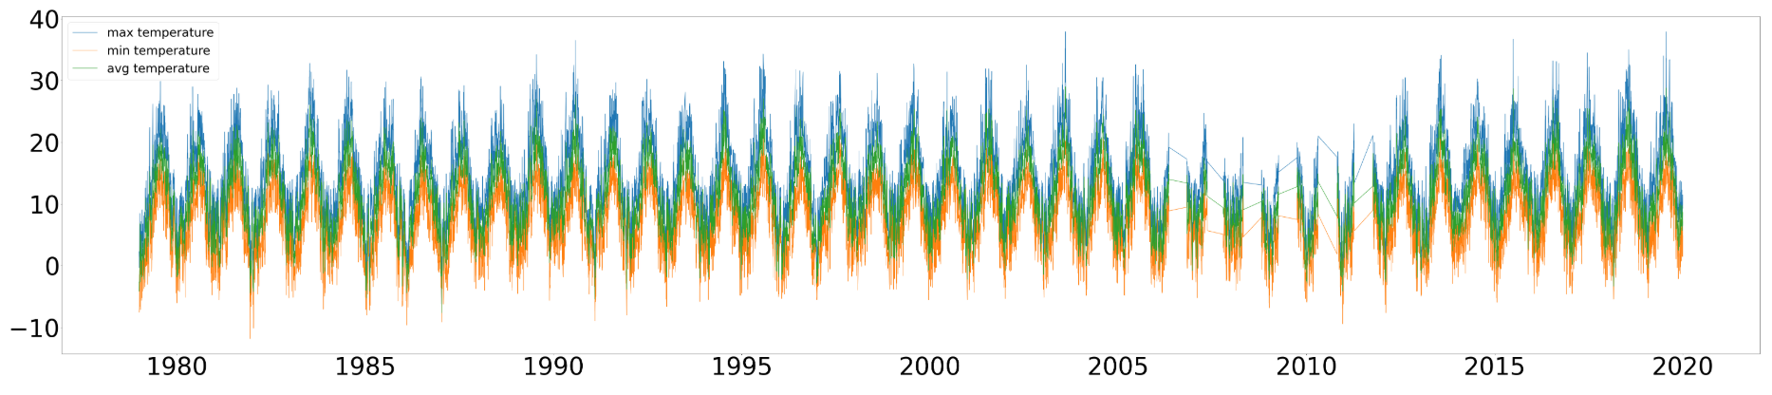
Plot Year vs. Temperature (in Celsius)

Slide 9
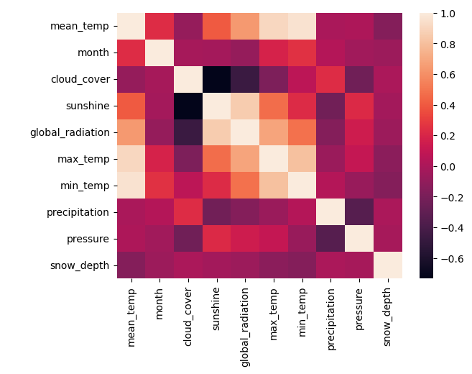
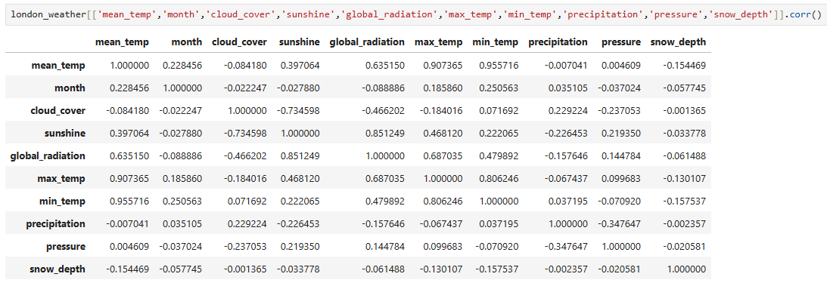
Correlation Matrix

Slide 10

Feature Engineering
Feature Engineering is useful to improve predictive modelling, ultimately leads to improving accuracy and performance. In this case, we drop features, maximum and minimum temperate since it gives a high correlation from the predictor mean temperature and snow depth since it has some empty values which can impact the accuracy of the model becoming less reliable.

Slide 11

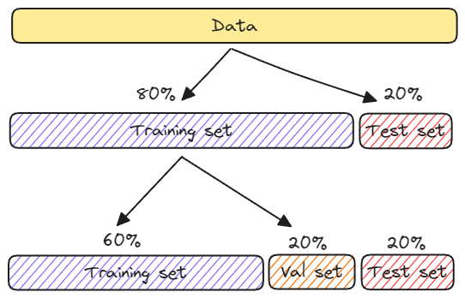
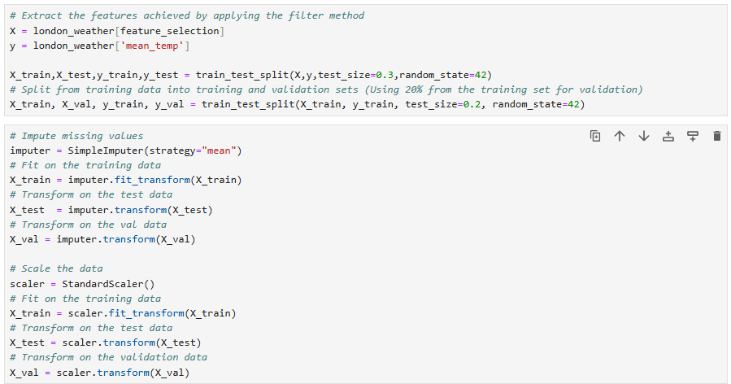
Machine Learning training and evaluation

Slide 12
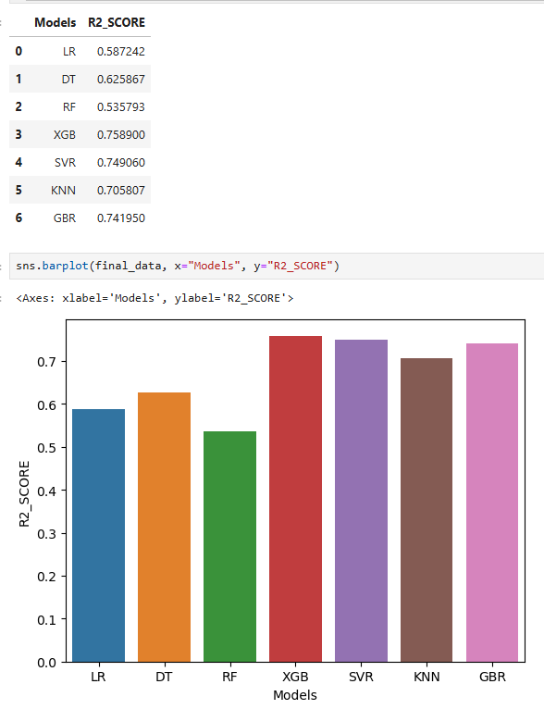
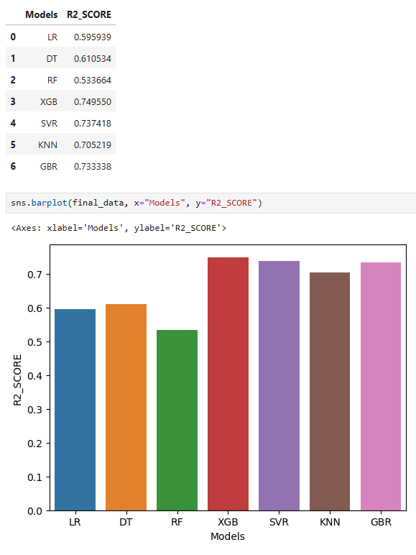
R-Squared Testing and Validation Data
Testing Data
Validation Data

Slide 13

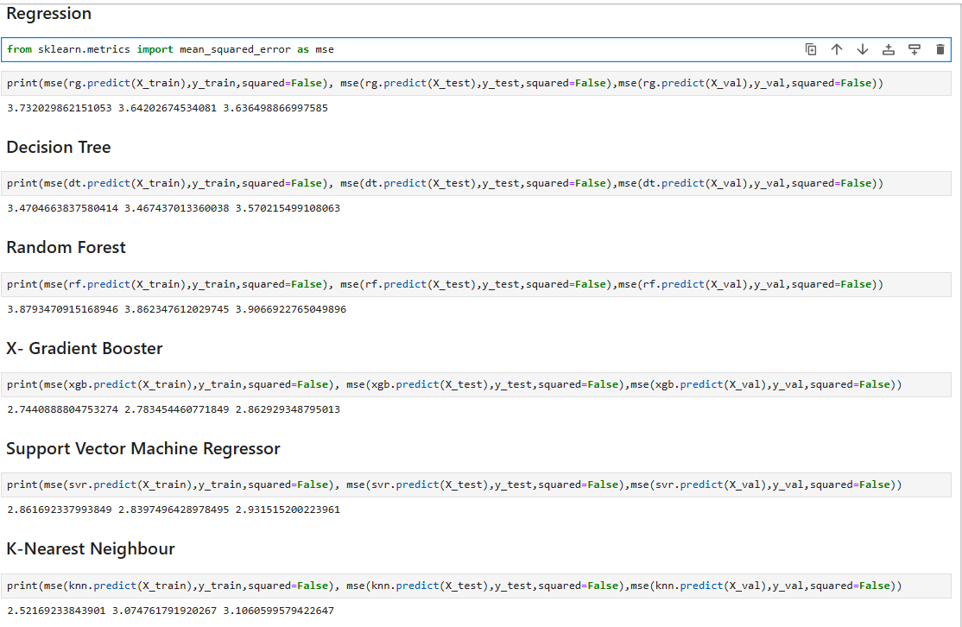
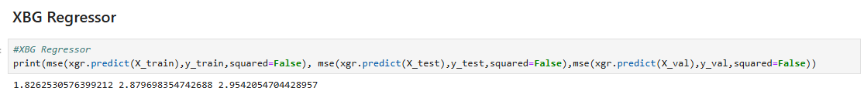
Root Mean Square Errors
When squared equals to FALSE gaves us the RMSE in Python,
it important to tell a quantifiable measure between the model’s prediction accuracy,
in regression tasks.
By averaging the squared differences between the actual and predicted values.
The smaller the values are the better the model fits for predicting modelling.

Slide 14
Conclusion
The best model to fit for this problem is X-Gradient Boost since it can handle complex data and non-linear relationships such as pressure, month, cloud cover, sunshine, precipitation and global radiation. Enables meteorologists to decide early warnings of storms, heat waves and natural disasters.
Although using a Logistic Regression would not be suitable in this case since it only works on cases where the predictor must have integers (e.g. nominal or ordinal values).
Notes:
In this slide, we will explore how weather patterns impact various aspects of our lives. Meteorologists play a critical role in analyzing data to make predictions about weather changes. Understanding these patterns is essential for agriculture, energy management, and preparing for climate change effects.

Slide 15

Link for the Data Collection and Feature Selection
https://www.kaggle.com/datasets/emmanuelfwerr/london-weather-data
How to Drop Out Highly Correlated Features in Python?

